Slide 1
Lesson objective
PBiS focus
Respect (stay seated)
Achieve (stay on task)
Title: Applying rates
Aim – be able to:
Use ratio techniques to compare two quantities in different units.
Write simplified rates
Plan:
Unitary method
Simplified rates

Slide 2
Simplified rates
Calculating an amount per single unit
E.g.
kilometers per hour
Meters per second
Teachers per student
Average points per game
Liters per minute
6km in 3 hours
200m in 12 seconds
12 students for 2 teachers
99 points over 3 games
400L in 90 minutes

Slide 3
Simplifying rates
6km in 3 hours ➔ Km/h?
200m in 12 seconds ➔ m/s?
12 students for 2 teachers
99 points over 3 games
400L in 90 minutes ➔ L/min
COPY:

Slide 4

Rates
Use ratio techniques to compare two quantities in different units
Kilometres per hour (kph)
Dollars per hour (hourly rate)
Dollars per 100g (best buy)
Find out the value of a single unit then multiply
How much is 250m of wire?
How much wire can you get for $420?
15m of fencing wire costs $9
How much does 250m of wire cost?
How much wire can you get for $420?
How much does 1m of wire cost?
How much wire can you get for $1?
Wire : Cost
Wire : Cost
15m : $9
15m : $9
Leave it in your calculator!
÷15
÷15
÷9
÷9
$0.60
$$1.\dot{6}$$
m
1m : …….
…….. : $1
x250
$150
x250
x420
700m
x420
250m : ……..
……… : $420

Slide 5
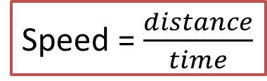
Speed as a rate
Use ratio techniques to compare distance and time
Speed is the distance covered per unit time
Kilometres per hour (kph)
Metres per second (m/s)
Speed = $\frac{distance}{time}$
A vehicle leaves Leeds at 8.00am and arrives in Newcastle at 10.30am. If the distance is 140km, what was the average speed of the vehicle?
Distance : Time
Speed over the whole journey
140km : 2.5hrs
÷2.5
56km
÷2.5
The average speed is 56kph
……….. : 1hr
David leaves London by car at 8.30am and arrives in Dundee at 5.30pm. If the car was travelling at an average speed of 75km/h, what is the distance from London to Dundee?
Distance : Time
75km : 1hr
x9
675km
x9
……… : 9hrs
It is 675km from London to Dundee

Slide 6
Rates
Kilometers per hour (km/h)
Trevor travels 231km in 3 hours
How long will it take him to travel 40km?
How far will he go in 5 hours?
Km : hours
Km : hours

Slide 7
Notes
Title of ratios
Given ratio (in order)
Find single unit and multiply

Slide 8
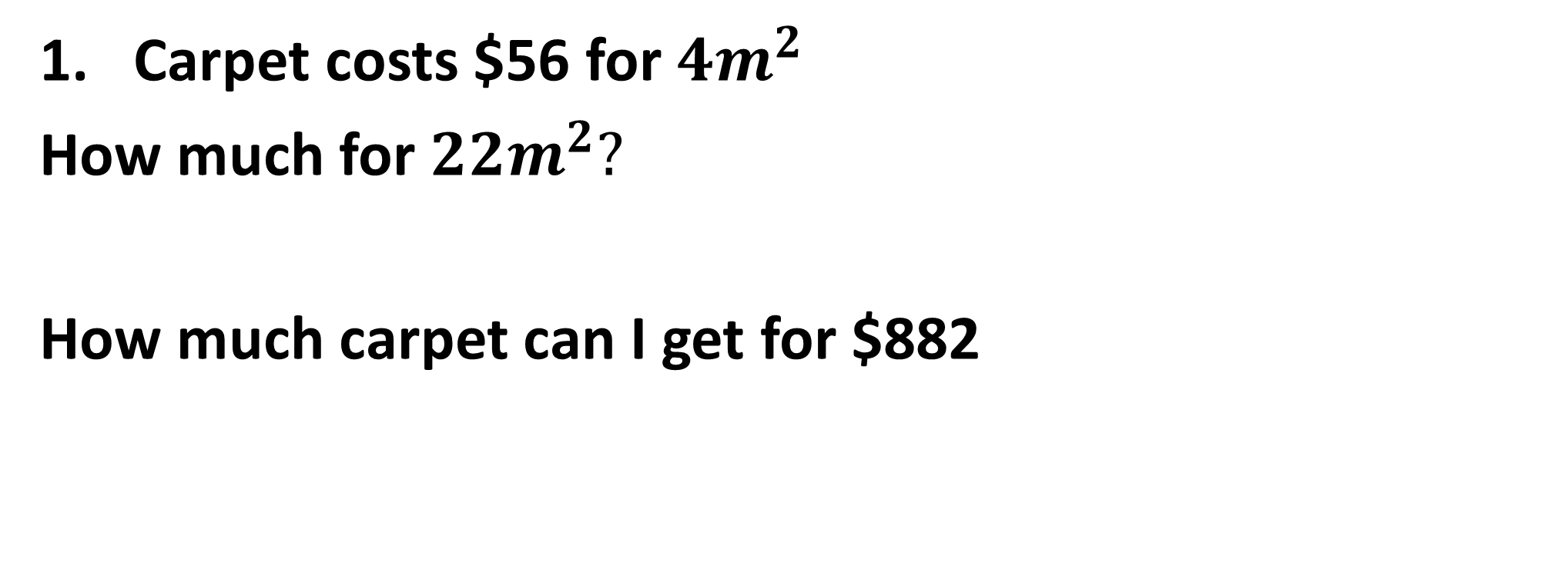
I do
Title of ratios
Given ratio (in order)
Find single unit and multiply
Carpet costs $56 for ${4m}^{2}$
How much for ${22m}^{2}?$
How much carpet can I get for $882

Slide 9
We do
Title of ratios
Given ratio (in order)
Find single unit and multiply
A sparky costs $650 for 8 hours of work.
How much would 3 hours cost?
How long with they work for $1137.50?

Slide 10
You do
Title of ratios
Given ratio (in order)
Find single unit and multiply
Sprite costs $18 for 3.6L
How much for 17L?
How many L will you get with $210?

Slide 11
5 in 5
A car travels 400km in 5 hours. How far will it travel in 7 hours?
Gary was paid $98 for 5 hours. How much will he be paid after 7hrs?
A tree grew 9cm in 3 months. What will it grow in 17 months?
Max rode 350km in a week. How far will he travel in 9 days?
John charges $430 for 6 hours. What would he charge for 11 hours?

Slide 12
Individual practice
Page 276
Questions 4 – 10

